Slide 1
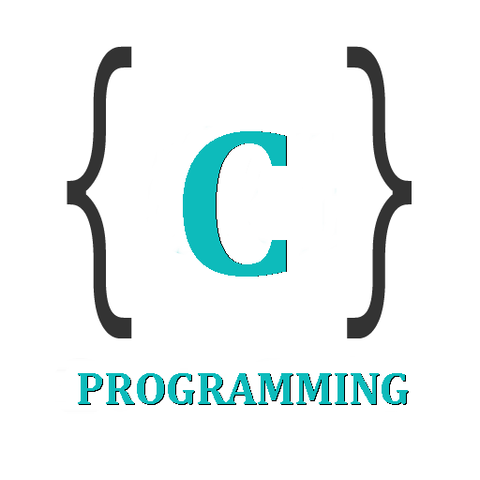

IT 105: Introduction to Programming
Dr. Manish Khare
Dr. Saurabh Tiwari
Lecture 9

Slide 2
Loop Control Instruction
  If you wish to find averages of 100 sets of three numbers, would you actually execute the program 100 times?
  Obviously Not
  There has to be a better way out.
  And that is Looping within program

Slide 3
Loops
The versatility of the computer lies in its ability to perform a set of instructions repeatedly.
This involves repeating some portion of the program either a specified number of times or until a particular condition is being satisfied.
There are three ways to repeat a part of a program.
They are
  Using a while statement
  Using a for statement
  Using a do-while statement

Slide 4
The while Loop
It is often case in programming that you want to repeat something a fixed number of times.
For ex. You want to calculate gross salaries of ten different persons, or you want to convert temperatures from centigrade to Fahrenheit for 15 different cities.
The while loop is ideally suited for this

Slide 5
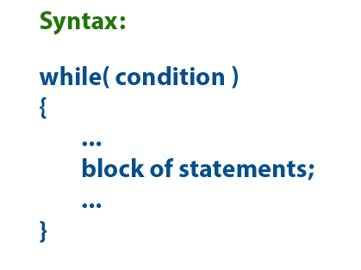
The general form of while loop is
initialize loop counter;
while (test loop counter using a condition)
{
do this;
and this;
increment loop counter;
}

Slide 6
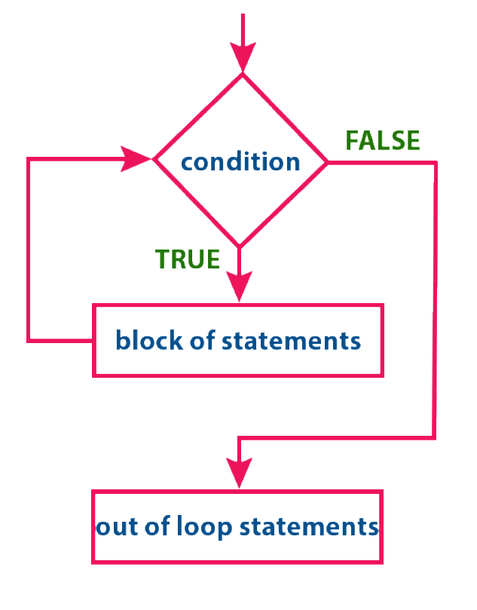


Slide 7
Let us a look that uses a while loop to calculate simple interest for 3 sets of values of principal, number of years and rate of interest
/* Calculation of simple interest for 3 sets of p, n and r */
main( )
{
int p, n, count ;
float r, si ;
Count =1;
while ( count <= 3 )
{
printf ( "\nEnter values of p, n and r " ) ;
Scanf (“%d %d %f", &p, &n, &r ) ;
si = n * r / 100 ;
printf ( "Simple interest = Rs. %f", si ) ;
count = count + 1;
}
}

Slide 8
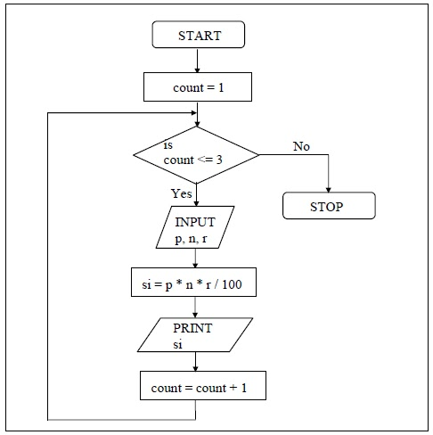

Slide 9
Some Trips on while loop
Note following point about while
  The statement within the while loop would keep getting executed till the condition being tested remains true. When the condition becomes false, the control passes to the first statement that follows the body of the while loop.
  In place of the condition, there can be any other valid expression. So long as the expression evaluates to a non-zero value, the statements within the loop would get executed.

Slide 10
The condition being tested may use relational or logical operators as shown in the following example.
  while ( i <= 10 )
  while ( i >= 10 && j <= 15 )
  while ( j > 10 && (b<15 || c<20))
The statements within the loop may consist a single line or block of statement. In the first case (single line within loop), the braces are optional, but in the second case (block of statement), the braces are mandatory.

Slide 11
As a rule the while must test a condition that will eventually become false, otherwise the loop would be executed forever., indefinitely.
main( )
{
int i = 1 ;
while (i<=10)
printf ( "%d\n",i);
}
This is an indefinite loop, since i remains equal to 1 forever.
The correct form would be as under:

Slide 12
main( )
{
  int i = 1 ;
  while (i<=10)
  {
    printf ( "%d\n",i);
    i=i+1;
  }
}

Slide 13
Instead of incrementing a loop counter, we can even decrement it and still manage to get the body of the loop executed repeatedly.
main()
{
  int i=5;
  while(i>=1)
    {
    printf("\n Make the computer literate! ");
    i=i-1;
    }
}

Slide 14
It is not necessary that a loop counter must only be an int. It can even be a float
main( )
{
  float a = 10.0 ;
  while (a<=10.5)
  {
    printf ( "\nRaindrops on roses…");
    printf ( "...and whiskers on kittens");
    a = a + 0.1 ;
  }
}

Slide 15
Even floating point loop counters can be decremented. Once again the increment and decrement could be by any value, not necessarily 1.

Slide 16
What do you think would be the output of the following program?
main( )
{
  while (i<=32767)
  {
    printf ("%d\n",i);
    i = i + 1 ;
  }
}

Slide 17
No, it doesn’t print numbers from 1 to 32767.
It’s an indefinite loop.
To begin with, it prints out numbers from 1 to 32767.
After that value of I is incremented by 1, therefore it tries to become 32768, which falls outside the valid integer range, so it goes to other side and becomes -32768 which would certainly satisfy the condition in the while.
This process goes on indefinitely

Slide 18
What will be the output of the following program?
main( )
{
  int i = 1 ;
  while (i<=10);
  {
    printf ("%d\n",i);
    i = i + 1 ;
  }
}

Slide 19
This is another indefinite loop, and it doesn’t give any output at all. The reason is, we have carelessly given a ; after the while. This would make the loop work like this...
while ( i <= 10 )
;
{
printf ( "%d\n",i);
i = i + 1;
}

Slide 20
Since the value of i is not getting incremented the control would keep rotating within the loop, eternally.
Note that enclosing printf() and i=i+1 within a pair of braces is not an error.
In fact we can put a pair of braces around any individual statement or set of statements without affecting the execution of the program.

Slide 21
More Operators
There are variety of operators which are frequently used with while.
To illustrate their usage let us consider a problem wherein numbers from 1 to 10 are to be printed on the screen.
The program for performing this task can be written using while in the following different ways:

Slide 22
Way 1
main( )
{
  int i = 1 ;
  while (i<=10)
  {
    printf ("%d\n",i);
    i = i + 1 ;
  }
}

Slide 23
Way 2
main( )
{
  int i = 1 ;
  while (i<=10);
  {
    printf ("%d\n",i);
    i++ ;
  }
}
Note that the increment operator ++ increments the value of i by 1, every time the statement i++ gets executed.
Similarly to reduce the value of a variable by 1 a decrement operator – is also available.

Slide 24
Way 3
main( )
{
  int i = 1 ;
  while (i<=10);
  {
    printf ("%d\n",i);
    i+=1 ;
  }
}
Note that += is a compound assignment operator. It increments the value of i by 1. Similarly, j = j + 10 can also be written as j += 10. Other compound assignment operators -=, *=, / = and %=.

Slide 25
Way 4
main( )
{
  int i = 0 ;
  while (i++<10);
  {
    printf ("%d\n",i);
  }
}
In the statement while (i++<10), firstly the comparison od value of i with 10 is performed, and then the incrementation of i takes place.
Since the incrementation of i happens after its usage, here the ++ operator is called a post incrementation operator.
When the control reaches printf(), i has already been incremented, hence i must be initialized to 0.

Slide 26
Way 5
main( )
{
  int i = 0 ;
  while (++i<10);
  {
    printf ("%d\n",i);
  }
}
In the statement while (i++<10), firstly incrementation of i takes place, then the comparison of value of i with 10 is performed.
Since the incrementation of i happens before its usage, here the ++ operator is called a pre-incrementation operator.

Slide 27
Exercise
What will be the output of the following program?
main( )
{
  int x = 4, y, z ;
  y = --x ;
  z = x-- ;
  printf ( "\n%d %d %d", x, y, z ) ;
}

Slide 28
main( )
{
  float x = 1.1 ;
  while ( x == 1.1 )
  {
    printf ( "\n%f", x ) ;
    x = x – 0.1 ;
  }
}

Slide 29
main( )
{
int x = 4, y = 0, z ;
while ( x >= 0 )
{
  if ( x == y )
  break ;
  else
  printf ("\n%d %d", x, y ) ;
  x-- ;
  y++ ;
  }
}

Slide 30
Write a program to find the factorial value of any number entered through the keyboard.

Slide 31
Write a program to enter the numbers till the user wants and at the end it should display the count of positive, negative and zeros entered.

Slide 32
Write a program to calculate overtime pay of 10 employees. Overtime is paid at the rate of Rs. 12.00 per hour for every hour worked above 40 hours. Assume that employees do not work for fractional part of an hour.

